Slide 1

Kickstarter Campaigns Analysis: Success or Failure
Parin Patel
Notes:
Olga

Slide 2

Overview
Problem Statement:
Kickstarter is currently the largest crowdfunding platform.
Pro: A wide variety of projects available.
Cons: Difficult to choose which project to invest in.
Helpful to be able to know the likelihood outcome of a project.
In other words, is this project worth your money?
Kickstarter crowdfunding campaigns dataset.
https://www.kaggle.com/yashkantharia/kickstarter-campaigns
Notes:
Problem Statement:
Background:
Kickstarter is a global crowdfunding platform where creators are about to find resources and support to help bring their projects and dreams to life.
Pro: A wide variety of projects available.
Cons: Difficult to choose which project to invest in.
Whether it be the creators ,that upload the projects, or members of the crowdfunding community, that aid others in achieving their goals, sometimes it is helpful to be able to know the likelihood outcome of a project.
In other words, is this project worth your money?

Slide 3
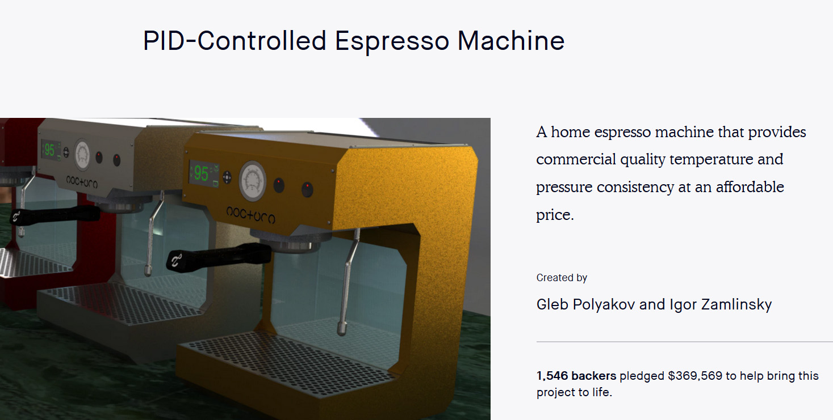
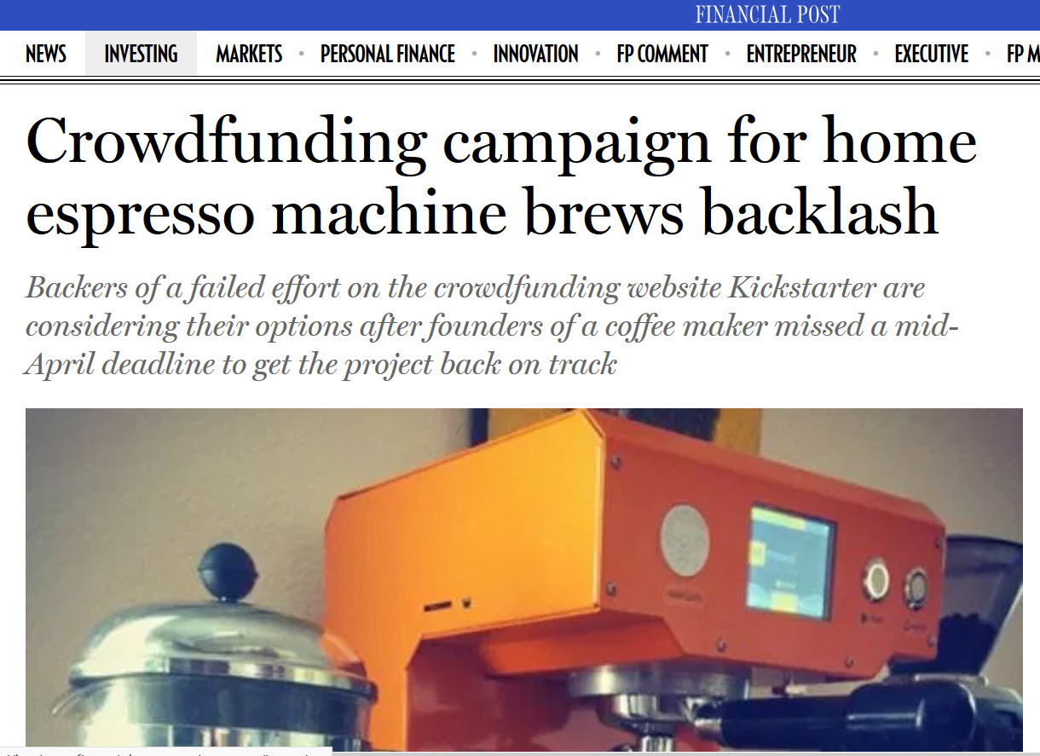
Kickstarter Case
From Success to Failure
Original Goal: 20K, raised: 369K
Coffeemaker plans never materialized and money were never returned to investors.

Slide 4
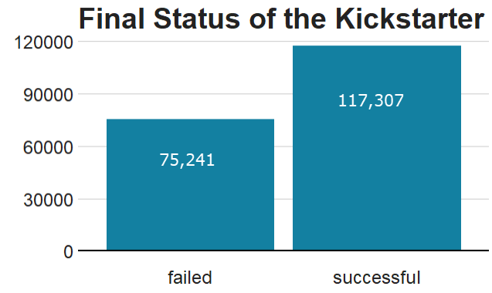
Goal
117,307
Can we predict what major factors result in a successful campaign?
75,241
Notes:
Just looking at the final status of the projects – we wanted to know what makes a campaign successful?

Slide 5
Data Questions
Big Overlying Questions
What are the key trends or factors (if any) in project success?
Are there any major differences between successful and failed projects?
Which variables were crucial in project outcome?

Slide 6
Our Data’s Story
Things we were able to learn from our data using descriptive statistics and other methods

Slide 7
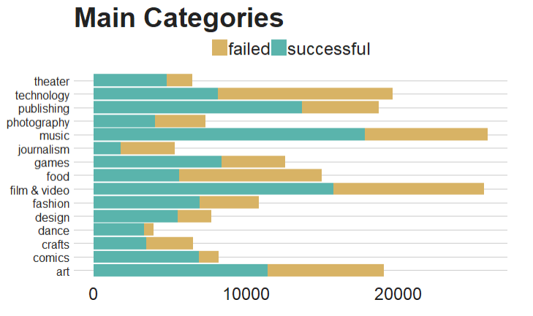
The Spread: Main Categories
Most Popular + Highest Success:
Music.
Film & Video
Least Popular + Lowest Success:
Dance
Journalism
Honorable Mention:
Food
Technology
Notes:
Most Popular + Highest Success:
Music - highest overall number of projects AND the highest successful number of projects overall.
Film & Video - second
Least Popular + Lowest Success:
Dance - lowest number of Projects, however, had a fairly high success rate.
Journalism - the overall 2nd lowest number of projects AND highest fail rate
Honorable Mention:
Food Category – fairly number of projects, but 2nd highest fail rate
Technology- (Which was interesting) 3rd highest number of Projects but just a higher fail rate than success rate. But wasn’t common in our top 5, where success was greater than failure.

Slide 8
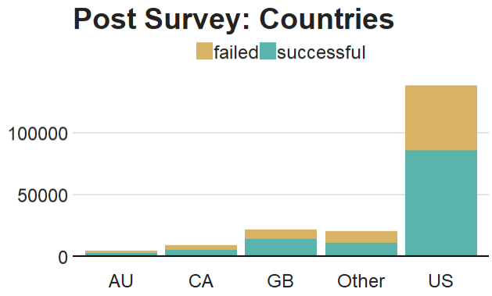
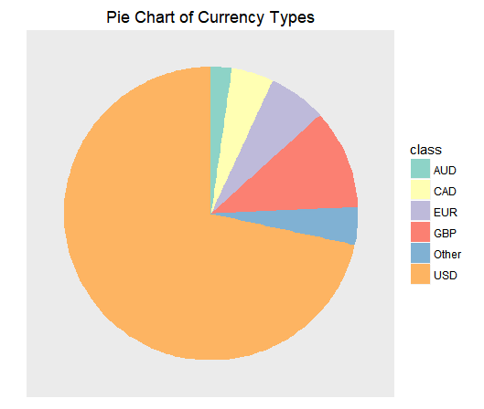
The Spread: Location of Projects
United States and USD has the highest number of Projects. US also had a high success rate
Notes:
US has the highest number of projects. Likely due to to Kickstarter being an American company that is based out of Brooklyn, NY. But might be interesting to compare this to gallup poll on Worlds most giving countries: https://www.gallup.com/analytics/245165/worlds-most-generous-countries-2018.aspx?utm_source=link_newsv9&utm_campaign=item_245192&utm_medium=copy
United States on average ranks high in countries where people are willing to donate money to strangers.

Slide 9
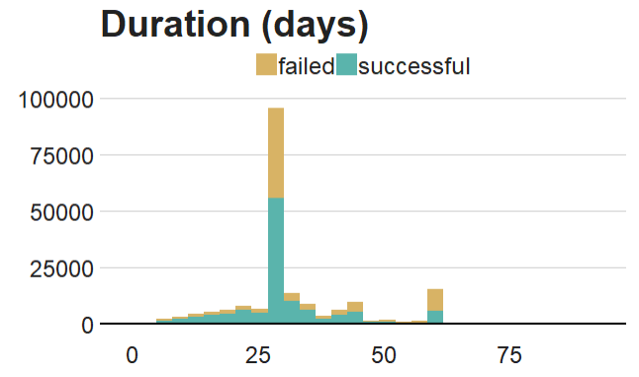
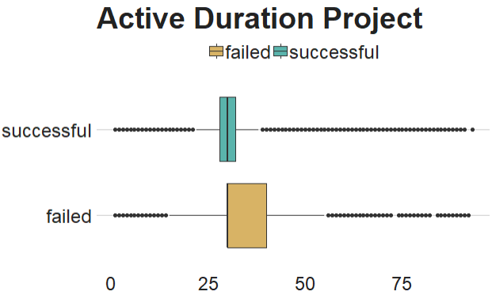
The Spread: Duration of Projects
Projects with the longer active durations had higher fail rates
Additionally, the largest number of overall projects fell within the 28 to 42 day duration range.

Slide 10
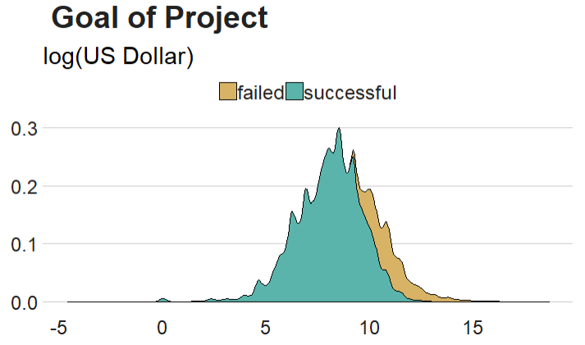
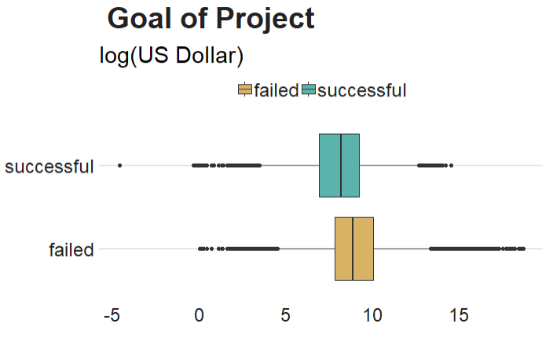
The Spread: Goals
No major difference in Goals between successful and failed projects
So while the mean of both status’s were similar,
the campaigns that failed were more likely to screw towards the higher goal amounts.

Slide 11
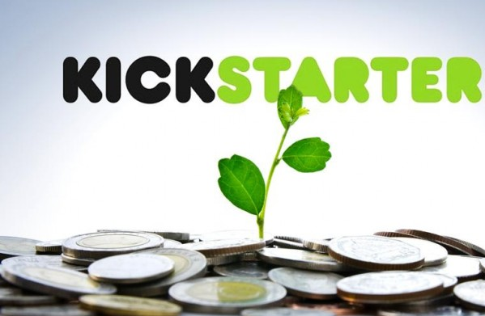
Predicting Campaign Success
Using data mining concepts to better predict a successful campaign

Slide 12
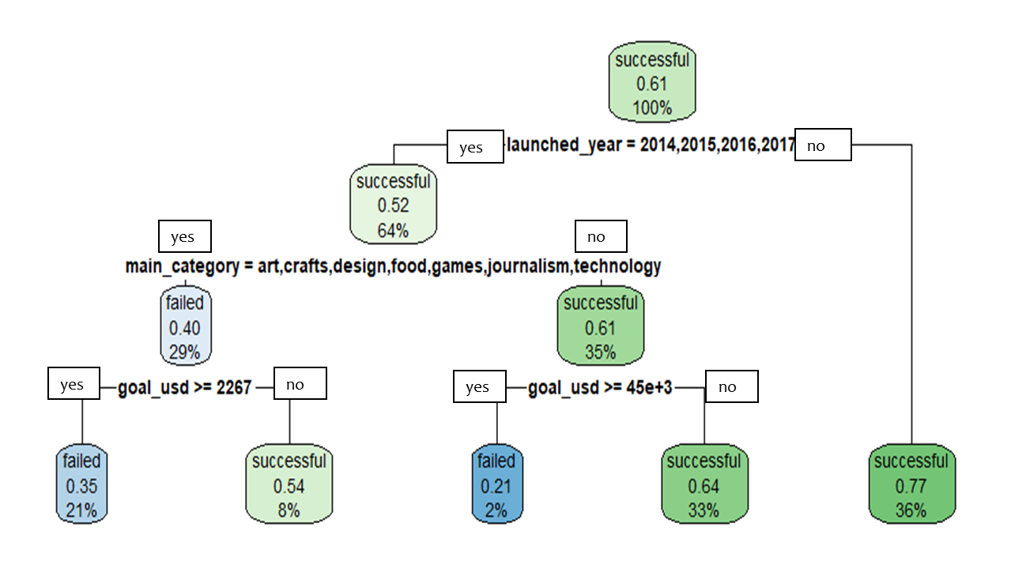
Classification Tree:
Results coincide with what we started to learn from our data earlier.
Highest Success Rate for Campaigns that :
Launched after year 2014
Is not:
art, craft, design, food, game, journalism, or technology
Has a USD Goal of less than $45,000
Notes:
We will first build a classification tree on the binary response variable “status”.

Slide 13
Logistic Regression
See that main categories plays a major role in project success.
For every one unit of change in the following categories the log odds of success increases the most.
Design
Film & Video
Games
Music
Publishing
Theatre
For every one unit of change in the following categories the log odds of failure increases the most.
Crafts
Food
Journalism
Technology
Photography

Slide 14
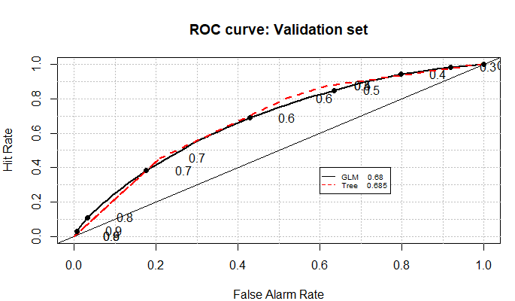
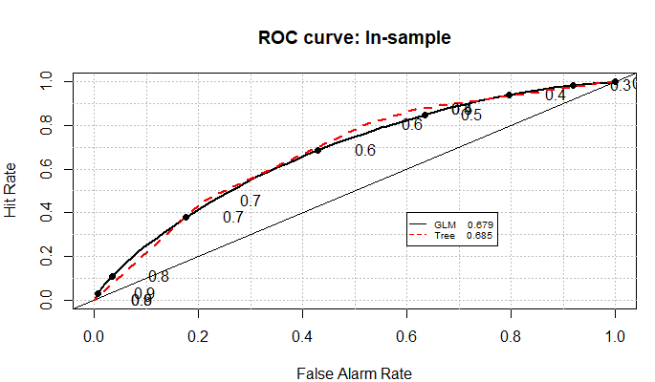
Comparison: Logit vs Tree
Compared the ROC curve of our classification tree and our logistic regression,
Determined that our logistic model barely did better than our tree. Overall both models were similar.
Therefore:
We plan to just these two models in conjunction when determining our final results
Notes:
As we tuned and created our final model, we realized we did not have to do much tuneing.
Our inspection of our second tune model shows our relative error does not change. It seems like our original model was tuned as best as it could be. Because of this, we chose to plot our ROC curve and assess our model through a contingency table and the area under the curve .From this, we are able to see that we have an error rate of around 36.38% (since the area under the curve is 0.6362).

Slide 15
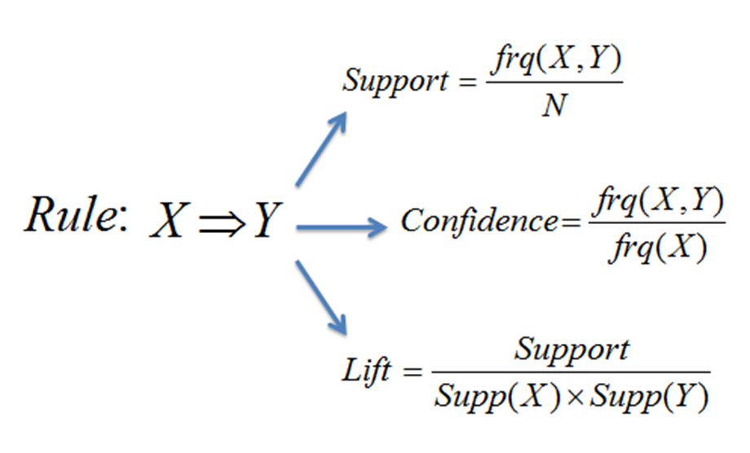
Association Rules Mining
Top Rules:
status=successful ==> end Quarter=Q4 conf: 0.28 and lift: 1.03
status=successful, start Quarter =Q4 ==> end Quarter conf: 0.75 and lift: 2.8
status=successful ==> end Quarter =Q2 conf: 0.26 and lift: 1.02

Slide 16
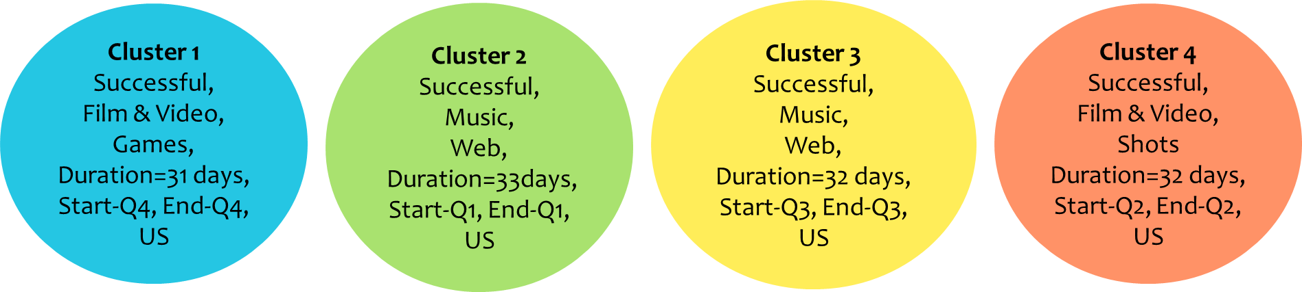
K-Means Clustering
K = 4
Notes:
This would make sense after looking back at our logistic regression model since categories like Film and Video and Music have the largest chance of increase for success. Also, these categories have the largest overall percent of projects. So by adding a new project into these categories, your change of being successful is higher than others.

Slide 17

Conclusion & Results
Based on our Analysis – Factors we would recommend for successful campaign.

Slide 18

A Successful Campaign Is…
In the categories: Film & Video or Music
Has a duration between 28-35 days
Is based out of the United States with USD currency
Has goals less than $45,000
Launched after 2014
Starts and Ends in the same quarter
Notes:
In conclusion, if someone wanted to understand their chance of having a successful Kickstarter campaign, like our inventors Gleb and Igor, it would be useful for them to look at their chance of success from the Kickstarter data.
Since our inventors are in two of the highest failing categories, technology and food. It might be a good idea for them to look to other sources for help.
Also, they may consider breaking up their Kickstarter into shorter projects with more reachable goals.
In addition, it is important to note that our Kickstarter dataset lacked information on the number of contributor that put money towards a campaign.

Slide 19

Thank You
Questions?

